Slide 1
Building the Internet of Things…
With JavaScript???

Slide 2
Hi. I’m Adam
ABOUT ME
I AM NOT
Adam Barney
Lincoln, NE
Barney Consulting
Microsoft MVP (C#)
Microsoft ASPInsider
Nebraska.Code()
Lincoln .NET Users Group
@cabarney
adam@adambarney.com
A JavaScript guy
A node.js guy
A hardware guy
So why am I here???

Slide 3
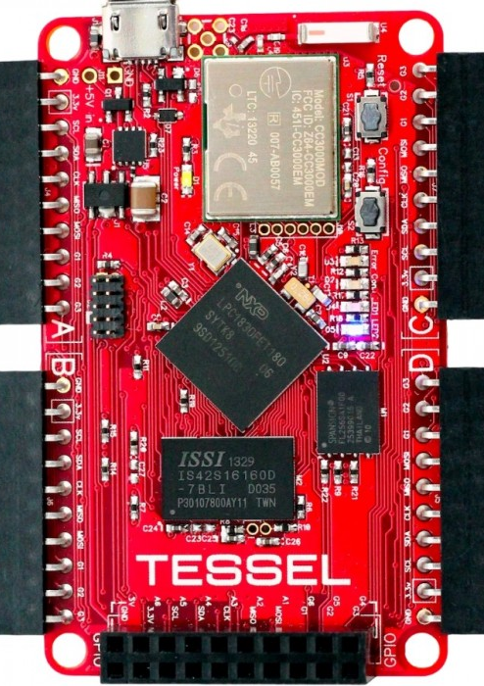

Tessel is a microcontroller that runs JavaScript. It's Node-compatible and ships with Wifi built in. Use it to easily make physical devices that connect to the web.

Slide 4
TI CC3000 WiFi radio built in
180MHz ARM Cortex M3 Microprocessor
32MB/ea RAM and Flash Memory
Micro USB or Batter Power
Programmable via JavaScript
Compatible with 10,000’s of node.js packages through npm
Deploy over USB or remotely by WiFi

Slide 5
Installing
Updating
Getting online
npm install tessel -g
tessel update
tessel wifi –n <ssid> -p <pw>

Slide 6
Blinking Lights
var tessel = require('tessel');
setInterval(function() {
tessel.led[0].toggle();
}, 100);
tessel run blink.js

Slide 7
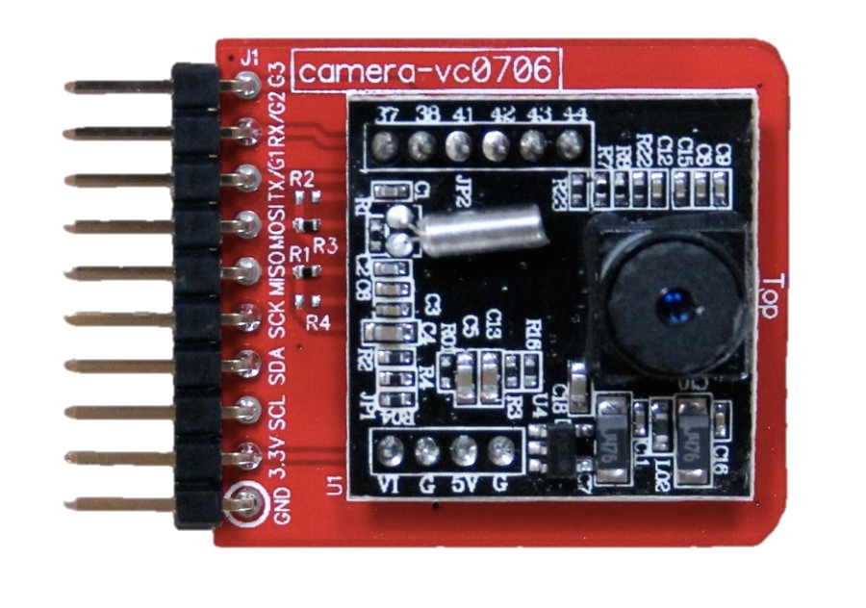

Slide 8
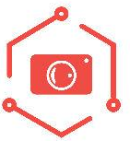
npm install camera-vc0706
camera.takePicture(function(){});

Slide 9

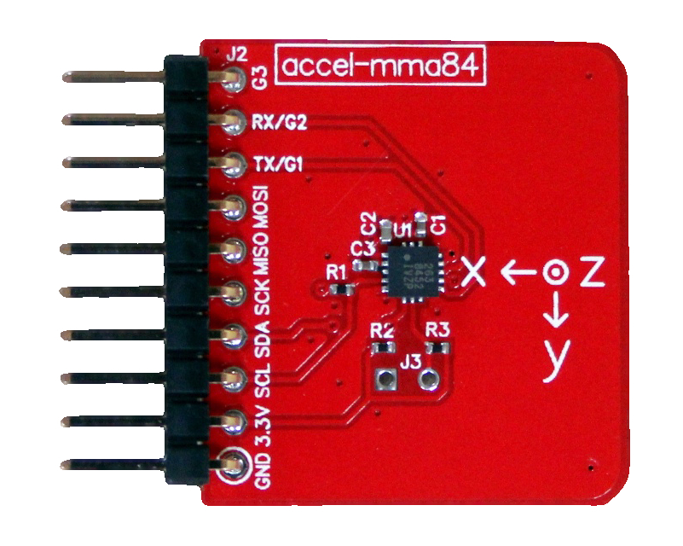

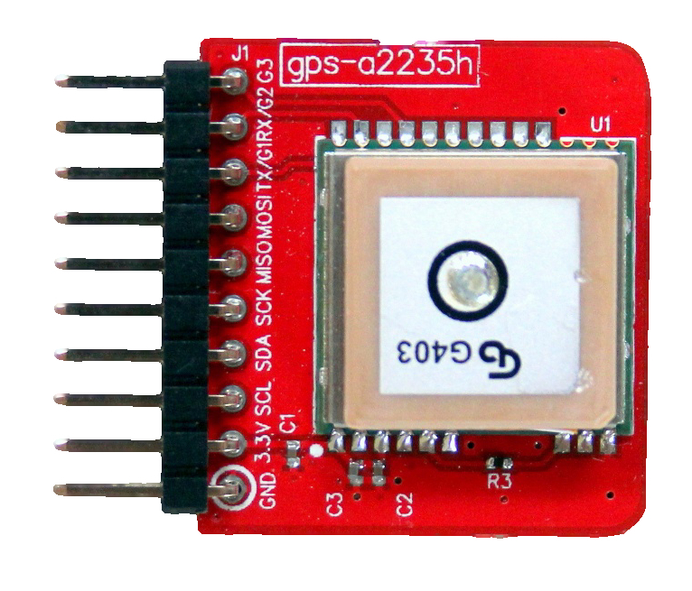

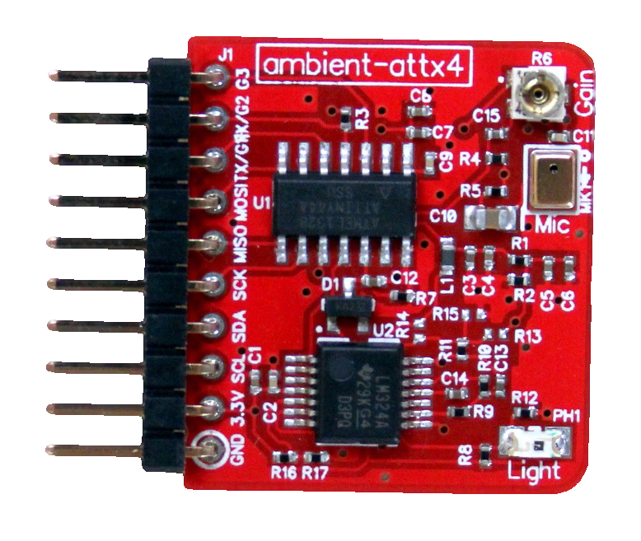

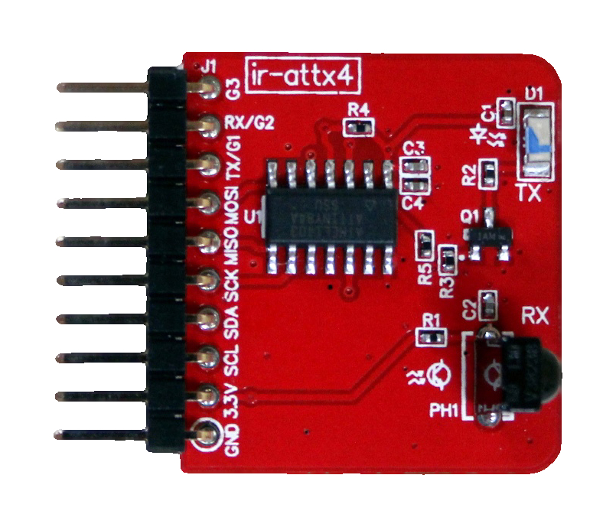

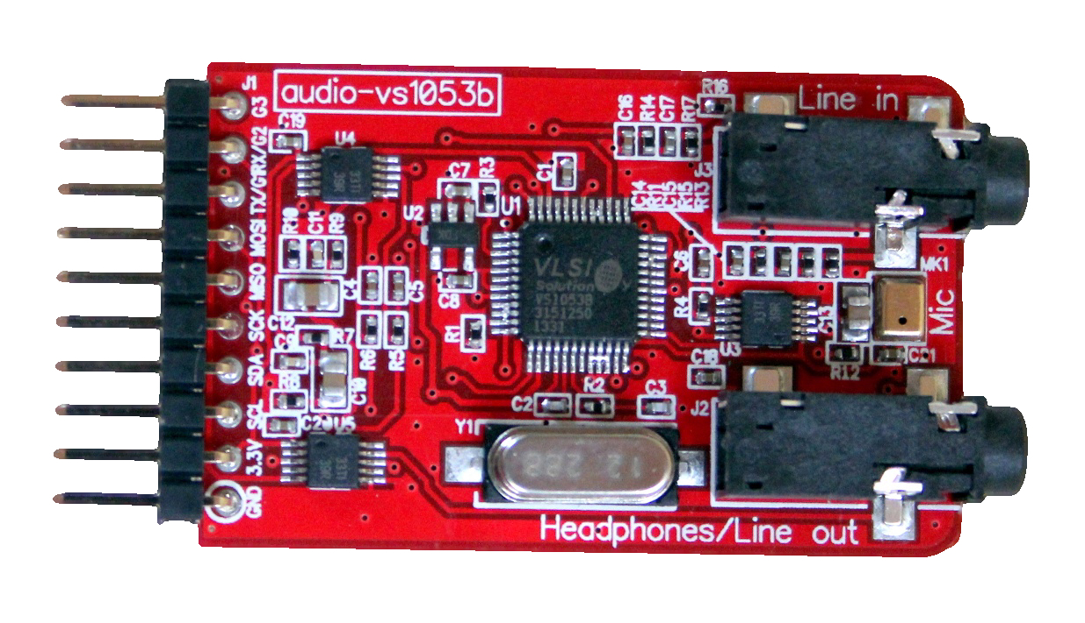

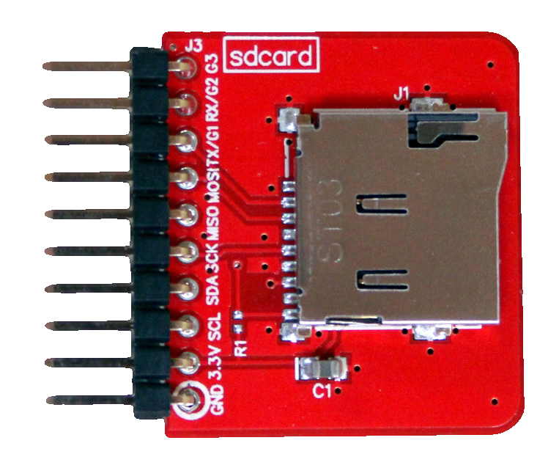

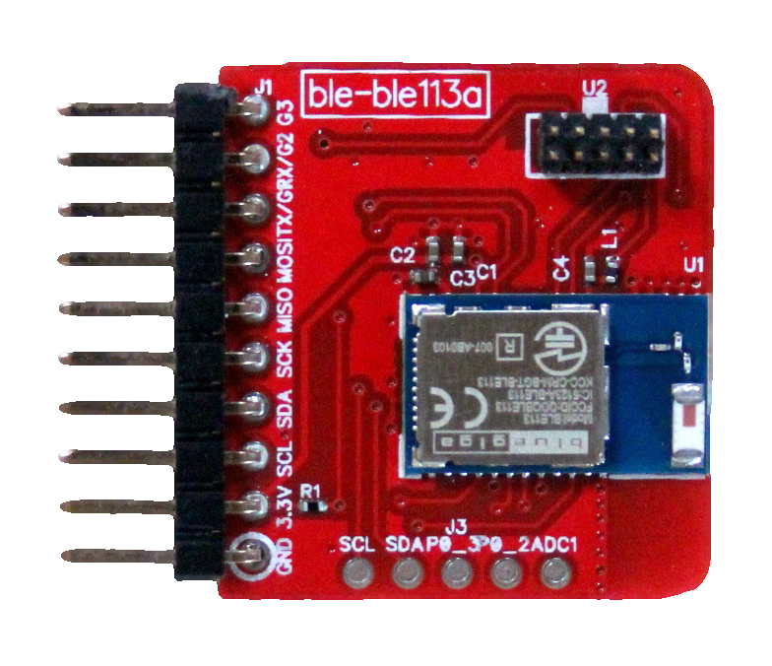

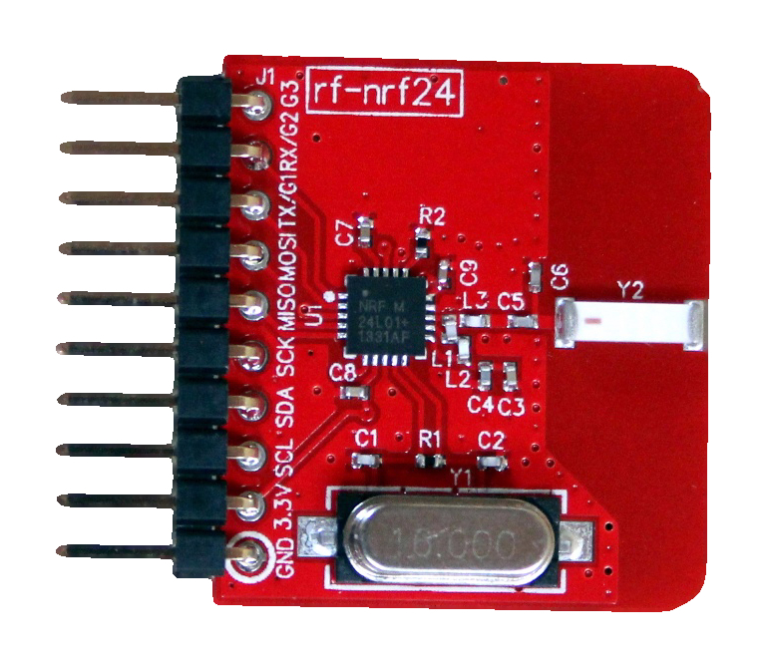

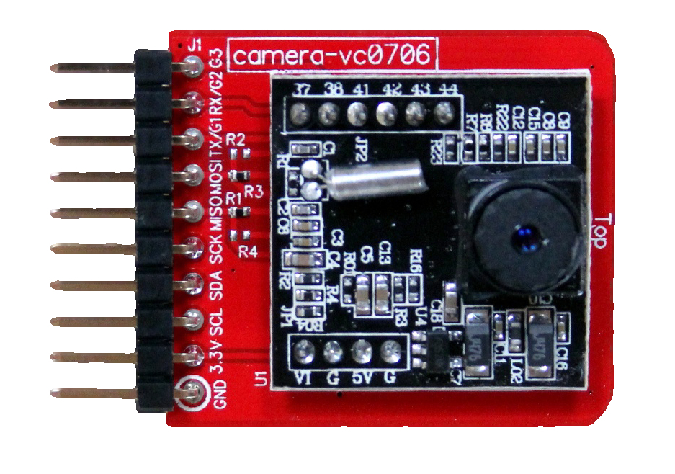

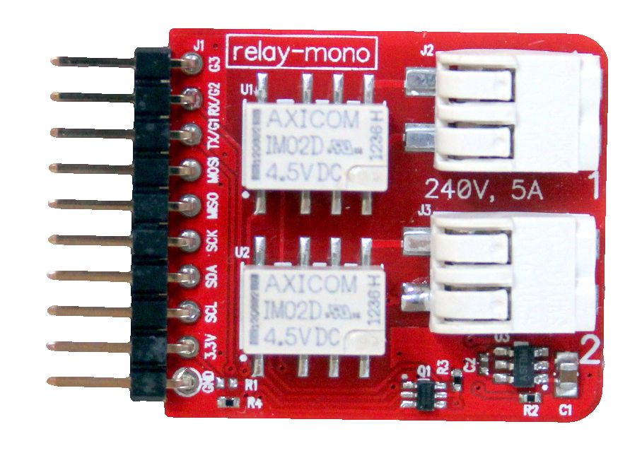

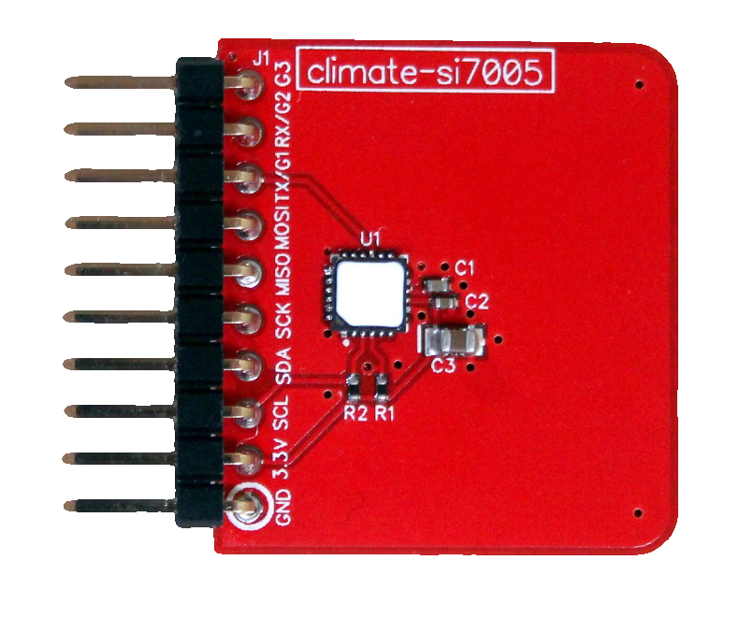

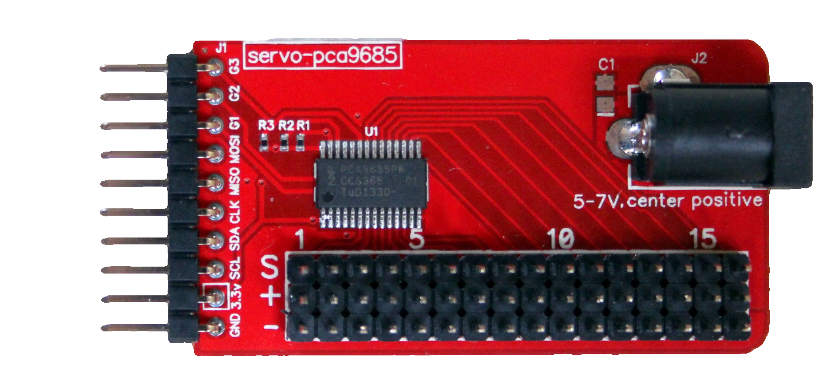
Accelerometer
GPS
Ambient
Infrared
Audio
MicroSD Card
Bluetooth
nRF24
Camera
Relay
Climate
Servo

Slide 10
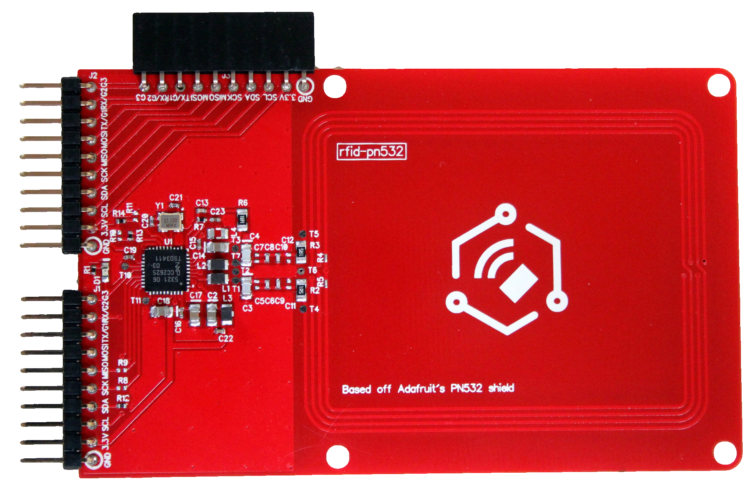

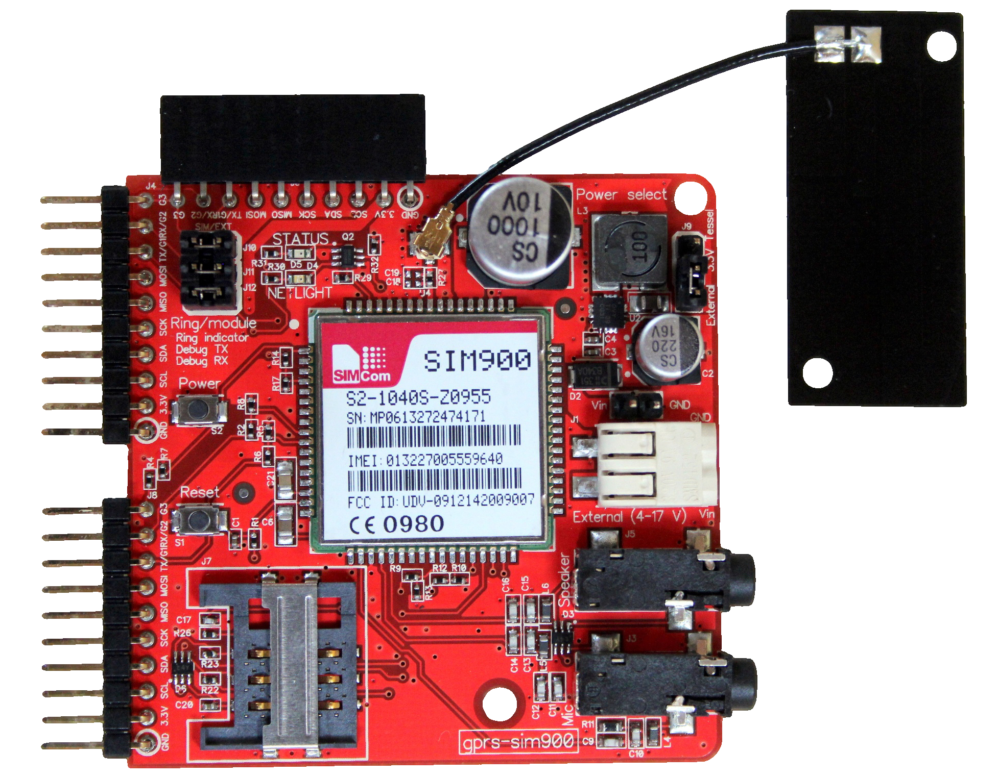

RFID
GPRS
(2G + Phone/SIM)
+10 community-contributed modules (and counting)

Slide 11
Ports
Pins
var portA = tessel.port['A'];
var gpio = tessel.port['GPIO'];
var rfid = lib.use(tessel.port['A']);
var pin = gpio.pin[‘G4'];
var pin = gpio.pwm[0];
var pin = gpio.analog[0];
var pin = gpio.digital[0];
pin.write(1); // output(1)
var val = pin.read();

Slide 12
Thermometer
Proximity
Motion
Liquid Flow
Cameras
Coin slots
Force
Moisture
Wind speed
Keypad
Touch
LCD Screens
NeoPixels
LED Panels
Fluid flow valves
Motors
Lasers
Speakers
Solenoids
Door locks
So many more…
So what can we do?

Slide 13
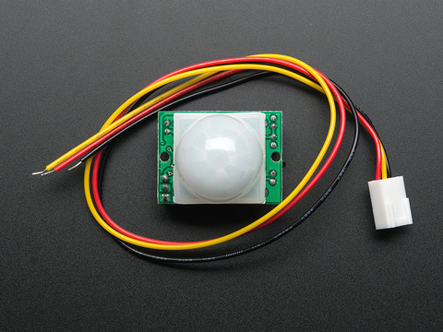
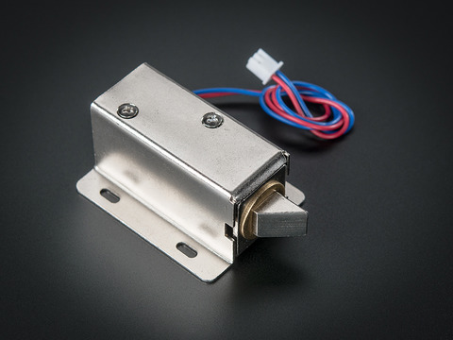
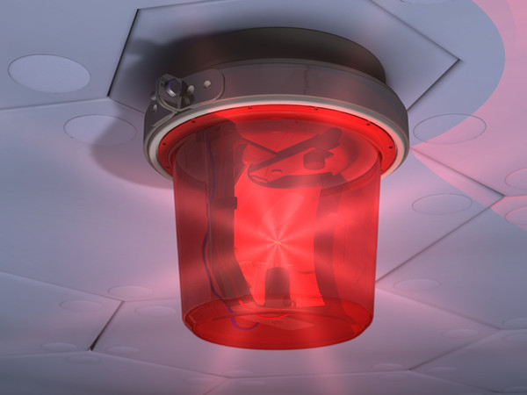
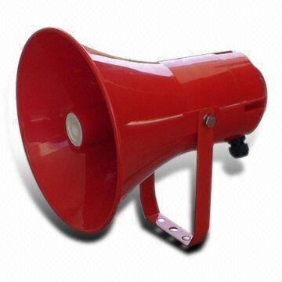
RFID
Audio
Relay
Notes:
Door access / alarm

Slide 14
Relay
Notes:
Motion activated lights (turn off the bathroom lights when you’re done!)

Slide 15
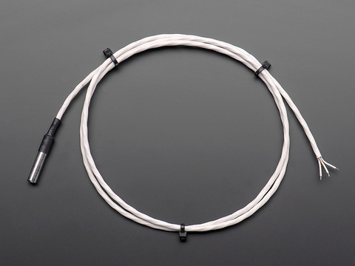
Servo
Notes:
BBQ temperature regulator

Slide 16
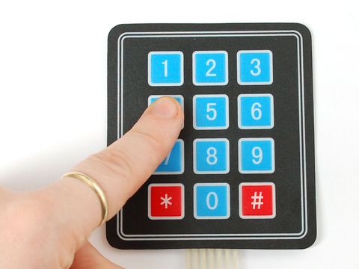
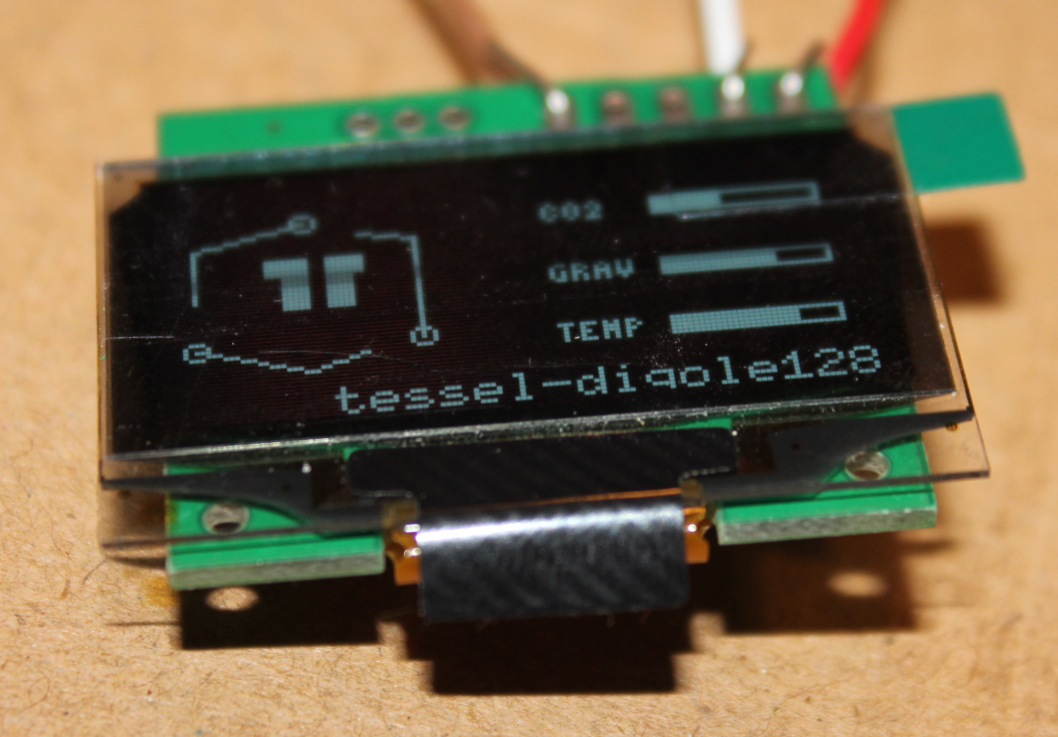
Audio
MicroSD Card
GPRS
(2G + Phone/SIM)
Notes:
A Phone!!! (with MP3 player)

Slide 17
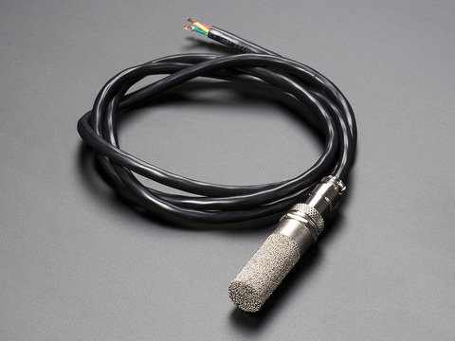
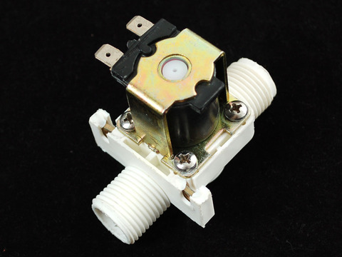
GPS
Climate
Notes:
Automated moisture-sensing watering system

Slide 18
GPS
Accelerometer
Camera
Notes:
Fleet tracking (add relay for teenage driver embarrassment)

Slide 19
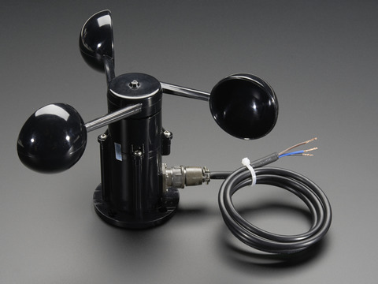
Relay
Notes:
Turn on/off power based on wind speed (inflatable Christmas yard decorations)

Slide 20
DEMOS

Slide 21
Questions?
adam@adambarney.com
tessel.io
10% Discount code (in case you didn’t get the text): “TESSEL-CODEMASH”

